Slide 1


Verification & Rust: Advanced Topics
Travis Hance (and the Verus Team)
CMU
MPI-SWS (to join soon)
https://verus.rs/

Slide 2
Rust’s restrictions & verification
Rust is widely seen as having a lot of “restrictions”
These restrictions are actually good for verification! When you stick to the well-trodden path, verification is often efficient and relatively painless

Slide 3
The well-trodden path
fn example(x: &mut u64, y: &mut u64) {
*x = *x + *y;
*y = *y / *x;
}
fn example2(x: u64, y: u64) -> (u64, u64) {
return (x + y, y / (x + y));
}
Rust’s reference system lets us make substantial simplifying assumptions
≈

Slide 4
Life before Rust
method test2(a: Ptr, b: Ptr)
requires a != b
{
// ...
}
method test3(a: Ptr, b: Ptr, c: Ptr)
requires a != b && b != c && a != c
{
// ...
}
method test4(a: Ptr, b: Ptr, c: Ptr, d: Ptr)
requires a != b && b != c && a != c
&& a != d && b != d && c != d
{
// ...
}
method test5(a: Ptr, b: Ptr, c: Ptr, d: Ptr, e: Ptr)
requires a != b && b != c && a != c
&& a != d && b != d && c != d
&& a != e && b != e && c != e && d != e
{
// ...
}
method test6(a: Ptr, b: Ptr, c: Ptr, d: Ptr, e: Ptr, f: Ptr)
requires a != b && b != c && a != c
&& a != d && b != d && c != d
&& a != e && b != e && c != e && d != e
&& a != f && b != f && c != f && d != f && e != f
{
// ...
}

Slide 5
function Repr() : set<object>
reads this, persistentIndirectionTable, ephemeralIndirectionTable,
frozenIndirectionTable, lru, cache, blockAllocator
{
{this} +
persistentIndirectionTable.Repr +
ephemeralIndirectionTable.Repr +
(if frozenIndirectionTable != null then frozenIndirectionTable.Repr else {}) +
lru.Repr +
cache.Repr +
blockAllocator.Repr
}
predicate ReprInv()
reads this, persistentIndirectionTable, ephemeralIndirectionTable,
frozenIndirectionTable, lru, cache, blockAllocator
reads Repr()
{
&& persistentIndirectionTable.Repr !! ephemeralIndirectionTable.Repr !! lru.Repr !! cache.Repr !! blockAllocator.Repr
&& (frozenIndirectionTable != null ==>
&& frozenIndirectionTable.Repr !! persistentIndirectionTable.Repr
&& frozenIndirectionTable.Repr !! ephemeralIndirectionTable.Repr
&& frozenIndirectionTable.Repr !! lru.Repr
&& frozenIndirectionTable.Repr !! cache.Repr
&& frozenIndirectionTable.Repr !! blockAllocator.Repr
)
&& this !in ephemeralIndirectionTable.Repr
&& this !in persistentIndirectionTable.Repr
&& (frozenIndirectionTable != null ==> this !in frozenIndirectionTable.Repr)
&& this !in lru.Repr
&& this !in cache.Repr
&& this !in blockAllocator.Repr
}

Slide 6
The well-trodden path
fn example(x: &mut u64, y: &mut u64) {
*x = *x + *y;
*y = *y / *x;
}
fn example2(x: u64, y: u64) -> (u64, u64) {
return (x + y, y / (x + y));
}
Rust’s reference system lets us make substantial simplifying assumptions
≈

Slide 7
The road less travelled
Head Tail

Slide 8
The road less travelled
Head Tail
This node has 2 “parents”

Slide 9
Rules are bent, not broken
There are still lines you can’t cross …
But you can do a lot in here.

Slide 10
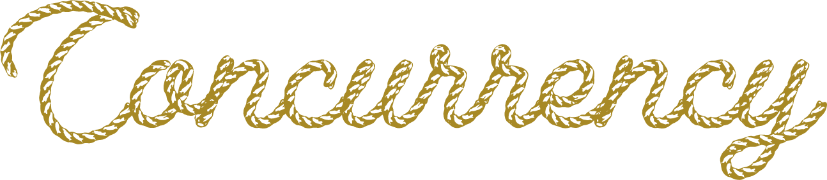
Unsafe Code
Interior mutability
Notes:
I’m going to be talking about 3 big topics today – interior mutability, unsafe code, and concurrency
[poll audience if they know what interior mutability, unsafe code are]
These 3 topics are actually highly interrelated, in that any code using 1 of them is very likely using 1 of the others as well. To verify significant systems requires us to be proficient in the art of composing all the related concepts. For this talk, though, I’ll try to distill each to its essence and a present a self-contained introduction to each, at least for the first 2.

Slide 11
Unsafe Code

Slide 12

What is unsafe code?
Definition attempt #1:
Unsafe code is code that opts the programmer out of the memory-safety guaranteed by Rust’s type system
fn oh_no() {
let p: *mut u64 = std::ptr::null_mut();
unsafe {
*p = 20;
}
}

Slide 13
What is unsafe code?
Definition attempt #1:
Unsafe code is code that opts the programmer out of the memory-safety guaranteed by Rust’s type system
fn oh_no() {
let p: *mut u64 = std::ptr::null_mut();
unsafe {
*p = 20;
}
}
This seems pretty bad — doesn’t Verus rely on this?

Slide 14
What is unsafe code?
Definition attempt #2:
Unsafe code is code that has additional requirements (beyond Rust’s type checker) to guarantee memory safety

Slide 15
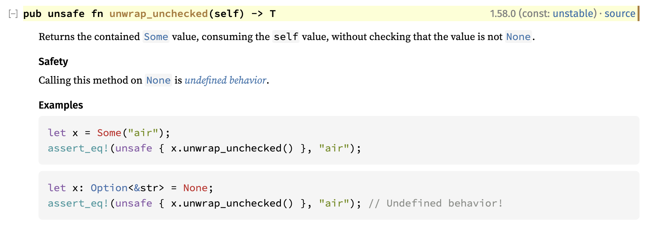
Example: Option::unwrap_unchecked
The subtext here is that behavior is defined if self is Some(_)
https://doc.rust-lang.org/std/option/enum.Option.html#method.unwrap_unchecked

Slide 16
What is unsafe code?
Unsafe code is really Conditionally Safe code — if the condition is satisfied, then it is safe
impl<T> Option<T> {
fn unwrap_unchecked(self) -> (res: T)
requires self.is_some()
ensures self == Some(res)
{
/* ... */
}
}
These conditions can be made explicit and formal using Verus preconditions

Slide 17
Unsafe Code

Slide 18

Unsafe Code
Notes:
Put this way, unsafe code doesn’t sound so bad. “Unsafe code” just means it has a requires clause, which is what you all have been practicing with all day. But —

Slide 19

Unsafe pointers

Slide 20
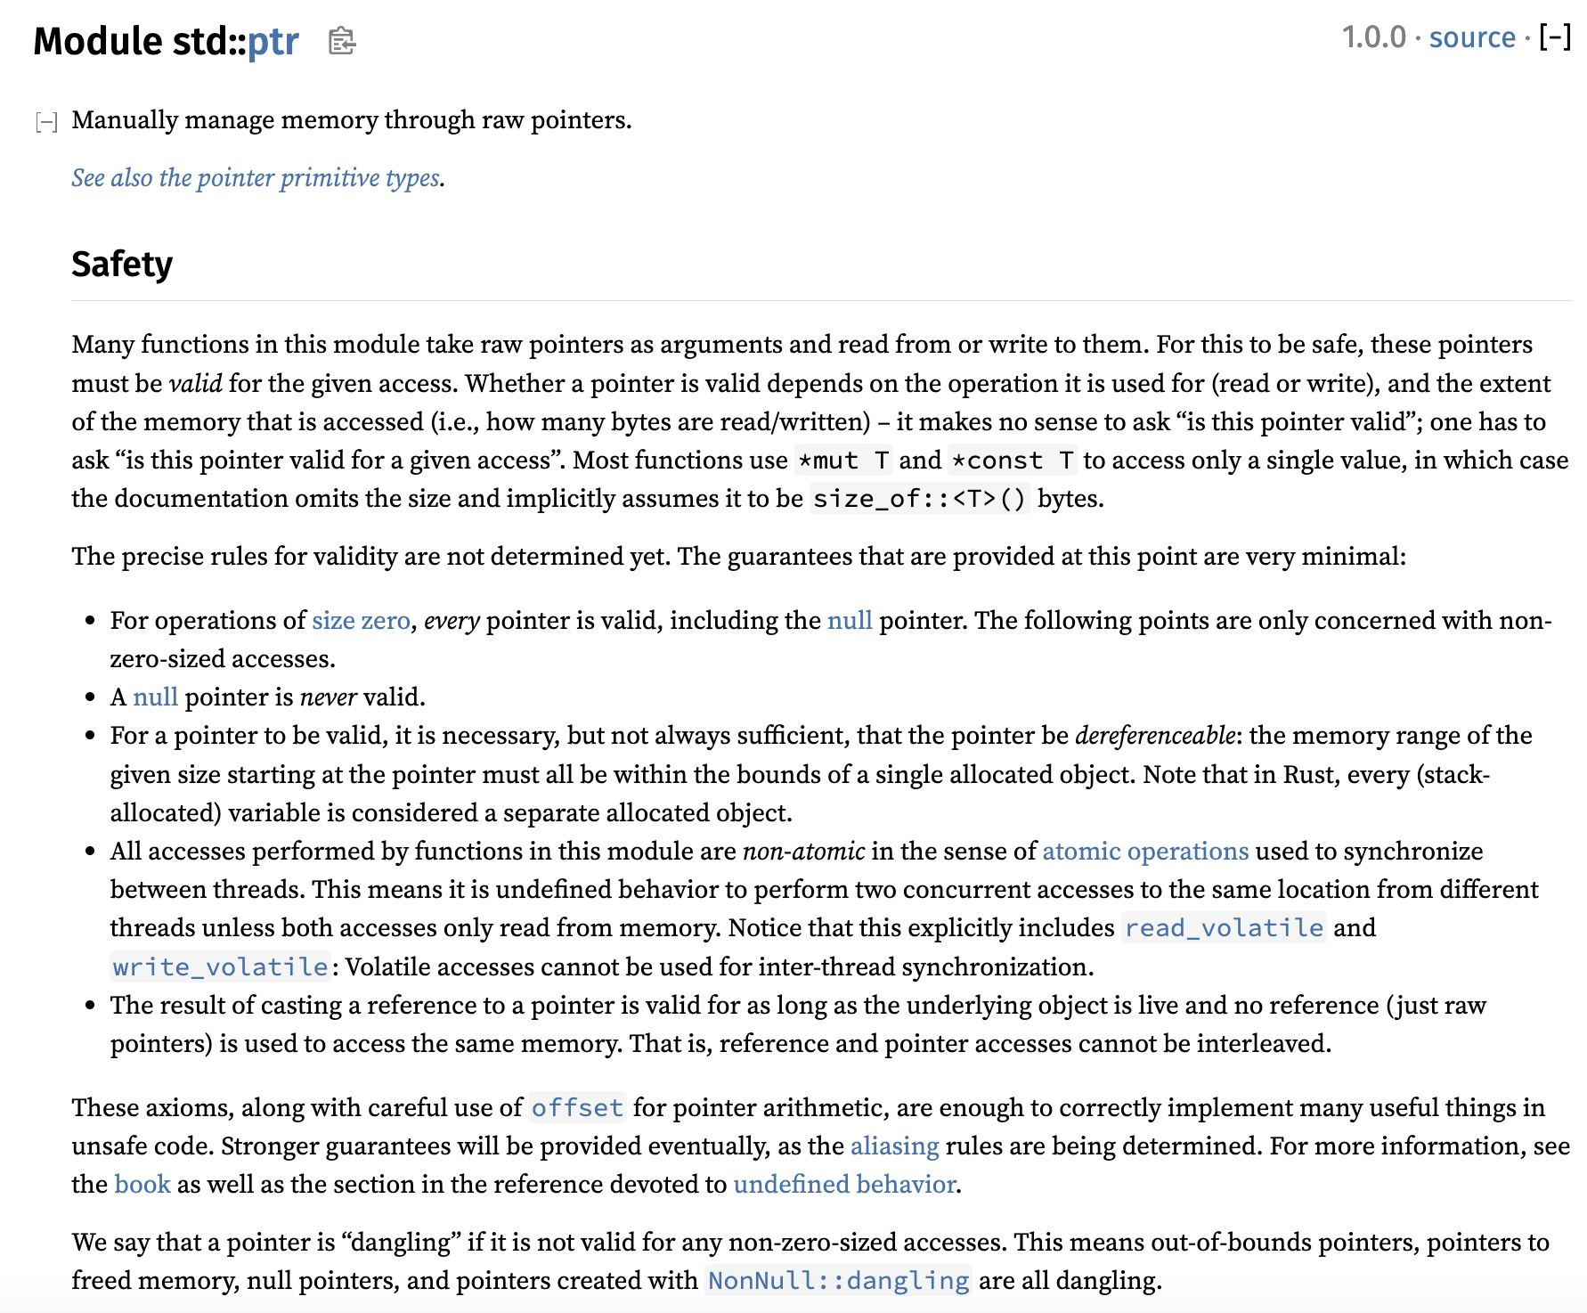
Let’s check the docs again

Slide 21
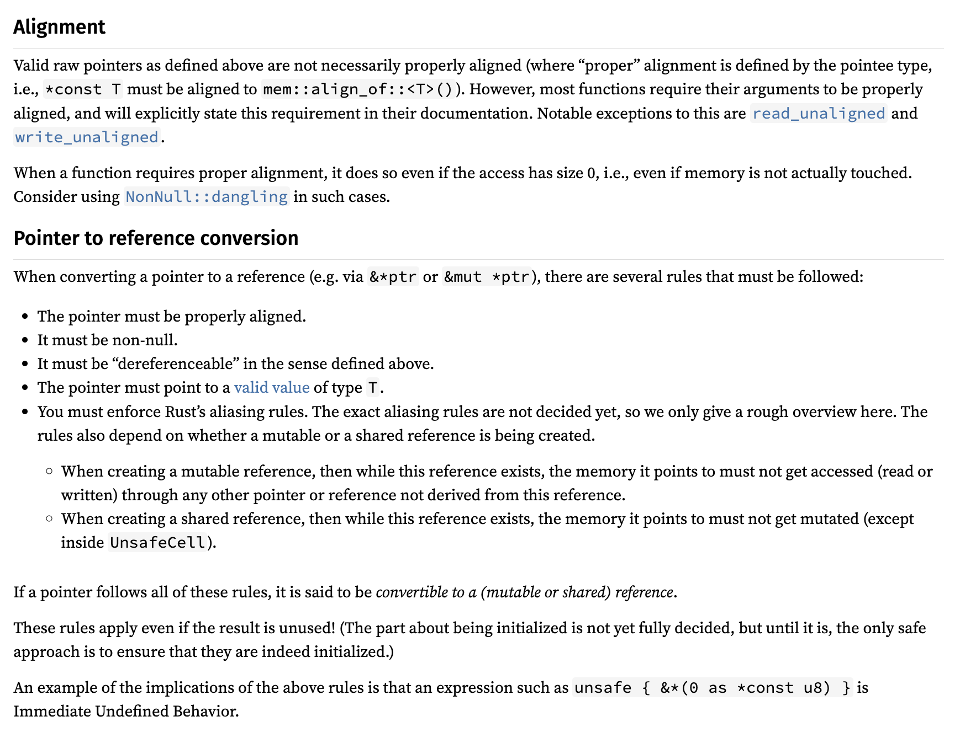
Let’s check the docs again

Slide 22
Let’s check the docs again
It keeps going, by the way

Slide 23
Pointers have a lot of conditions
Accessing a pointer requires:
Memory is valid, allocated, well-aligned
Reads must be initialized
Accesses are data-race-free
Playing nice with reference system (&T and &mut T)
Handling “pointer provenance”
Can these conditions even be expressed via Verus preconditions?

Slide 24

Isn’t this what ownership types are for?
Ordinarily, Rust’s type system, together with its clever standard library types (&T, &mut T, Box<T>, Rc<T>, Arc<T>, RefCell<T>, …), ensure that all the rules are followed
But the whole point of using “raw pointers” is that we can’t use those types…
Now we’re just going in circles!
Notes:
The point is that Rust does have the capability to cleanly reason about these concepts, it’s just slightly out of reach. We need to grasp a little farther.

Slide 25
Isn’t this what ownership types are for?
Ordinarily, Rust’s type system, together with its clever standard library types (&T, &mut T, Box<T>, Rc<T>, Arc<T>, RefCell<T>, …), ensure that all the rules are followed
But the whole point of using “raw pointers” is that we can’t use those types…
Solution: Decouple the ownership reasoning from the physical pointers; reason about ownership in “proof code”

Slide 26
Pointers have a lot of conditions
Accessing a pointer requires:
Memory is valid, allocated, well-aligned
Reads must be initialized
Accesses are data-race-free
Place nice with reference system (&T and &mut T)
Handling “pointer provenance”
For the demo & exercise, we’ll use Verus’s “Simple PPtr” library, which sands down the rougher edges at the cost of generality — but it still covers the key points

Slide 27
[PPtr demo]

Slide 28
Summary
Safety ensured by preconditions
Safety ensured by ownership types
&mut T
Option::unwrap_unchecked
&T
Raw ptrs
Box<T>
Arc<T>
Rc<T>
“Unsafe code”
“Safe code”

Slide 29
Interior mutability

Slide 30

What is interior mutability?
Rust’s references are usually described to new users as follows:
Type
&mut T | Unique | Mutable
&T | Shared | Immutable
Unfortunately it’s not entirely correct …
Sometimes described as “shared XOR mutable,” this is an important property that enables Rust’s memory safety & Verus’s efficient SMT encoding

Slide 31
What is interior mutability?
Interior mutability is a pattern wherein you can modify data behind a shared reference (&).
However, this is only possible through specialized “interior mutability” types (e.g., Cell, RefCell, Mutex, RwLock, UnsafeCell)
This is good, because unrestricted mutation-through-& would ruin all the theory behind Verus’s encoding
As it is, we can restrict the additional complexity only to when these specialized types are involved

Slide 32
What’s the problem?
fn example(cell1: &Cell<u64>, cell2: &Cell<u64>)
-> (u64, u64)
{
cell1.set(24);
cell2.set(25);
let x = cell1.get();
let y = cell2.get();
(x, y)
}
cell1 = 24
cell2 = 25
x = 24
y = 25
(x, y) = (24, 25)
Notes:
This is obviously wrong … if it seems laughably naïve to you, though, I want to emphasize that this is basically how Verus works 90% of the time, when you’re working with “normal” reference types

Slide 33
What’s the problem?
fn example(cell1: &Cell<u64>, cell2: &Cell<u64>)
-> (u64, u64)
{
cell1.set(24);
cell2.set(25);
let x = cell1.get();
let y = cell2.get();
(x, y)
}
cell1 = 24
cell2 = 25
x = 24
y = 25
But (25, 25) is possible!
(x, y) = (24, 25)
Notes:
This is obviously wrong … if it seems laughably naïve to you, though, I want to emphasize that this is basically how Verus works 90% of the time, when you’re working with “normal” reference types

Slide 34
What’s the problem?
fn example(cell1: &Cell<u64>, cell2: &Cell<u64>)
-> (u64, u64)
{
cell1.set(24);
cell2.set(25);
let x = cell1.get();
let y = cell2.get();
(x, y)
}
Option 1: Maintain a “cell heap”
Heap = [ cell1 |--> 24 ; cell2 |--> 25 ]
(and cell1 ≠ cell2)
Or
Heap = [ cell1 |--> 25]
(and cell1 = cell2)
This “leaks” the mutability everywhere
Notes:
This is obviously wrong … if it seems laughably naïve to you, though, I want to emphasize that this is basically how Verus works 90% of the time, when you’re working with “normal” reference types

Slide 35

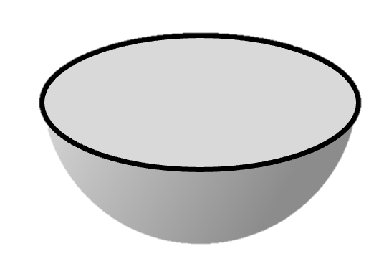
We’d prefer to encapsulate mutation
The whole point of interior mutability is to “pretend” that something mutable is immutable.
Verification should reflect that.
&mut T
Let’s do an example to see why we care

Slide 36
Example: Memoizing a deterministic fn
Suppose we have some expensive but deterministic computation
pub fn expensive_function(args: &Args) -> Output {
/* ... */
}
struct Memoizer {
map: HashMap<Args, Output>
}
impl Memoizer {
pub fn get(&mut self, args: &Args) -> Output {
match self.map.get(args) {
Some(result) => result.clone(),
None => {
// Compute for the first time and store the result for next time
let result = expensive_function(args);
self.map.insert(args.clone(), result.clone());
result
}
}
}
}
We can memoize the results — lazily populate a lookup-table of results, as-needed

Slide 37
Example: Memoizing a deterministic fn
Now, what if we want to share the Memoizer across multiple subsystems? Maybe even across threads?
Arc<Memoizer> → &Memoizer
Whoops, now we can’t call get:
fn get(&mut self, args: &Args)

Slide 38
Example: Memoizing a deterministic fn
pub fn expensive_function(args: &Args) -> Output {
/* ... */
}
struct Memoizer {
map: HashMap<Args, Output>
}
impl Memoizer {
pub fn get(&mut self, args: &Args) -> Output {
match self.map.get(args) {
Some(result) => result.clone(),
None => {
// Compute for the first time and store the result for next time
let result = expensive_function(args);
self.map.insert(args.clone(), result.clone());
result
}
}
}
}

Slide 39
Example: Memoizing a deterministic fn
We really want to implement this instead:
fn get(&self, args: &Args)
For this we can use interior mutability …

Slide 40
Example: Memoizing a deterministic fn
pub fn expensive_function(args: &Args) -> Output {
/* ... */
}
struct Memoizer {
ref_cell: RefCell<HashMap<Args, Output>>
}
impl Memoizer {
pub fn get(&self, args: &Args) -> Output {
let map_handle = self.ref_cell.borrow_mut();
match map_handle.get(args) {
Some(result) => result.clone(), None => {
// Compute for the first time and store the result for next time
let result = expensive_function(args);
map_handle.insert(args.clone(), result.clone());
result
}
}
}
}

Slide 41
Example: Memoizing a deterministic fn
Now we have this beautiful type signature that hides the mutability:
fn get(&self, args: &Args)
The Verus specification should be equally concise:
no “modifies” clause
no passing in “write-permissions”
etc.
&mut T

Slide 42
Solution: What doesn’t change?
If Verus can’t treat like &Cell<u64> as a u64 because the u64 might change … let’s treat it like something that doesn’t change
What doesn’t change? An invariant.
An invariant = predicate describing the “allowed possible values”
Forget about tracking the precise value; only track the invariant

Slide 43
[Invariants demo]

Slide 44
Interior mutability types
Cell
RefCell
Mutex
RwLock

Slide 45
Interior mutability types
Cell
RefCell
Mutex
RwLock
For single-threaded use

Slide 46
Interior mutability types
Cell
RefCell
Mutex
RwLock
For single-threaded use
Thread-safe; for multi-threaded use
There’s a spectrum of trade-offs in terms of overhead / flexibility

Slide 47
An encapsulating specification
Using cell invariants / lock invariants, we can prove the following spec:
pub spec fn func(args: &Args) -> Output { ... }
pub fn expensive_function(args: &Args) -> (output: Output)
ensures output == func(args)
{ ... }
impl Memoizer {
pub fn get(&self, args: &Args) -> (output: Output)
ensures output == func(args)
{ ... }
}
Function must be deterministic
Memoizer is deterministic and computes the same function

Slide 48
An encapsulating specification
Using cell invariants / lock invariants, we can prove the following spec:
pub spec fn func(args: &Args) -> Output { ... }
pub fn expensive_function(args: &Args) -> (output: Output)
ensures output == func(args)
{ ... }
impl Memoizer {
pub fn get(&self, args: &Args) -> (output: Output)
ensures output == func(args)
{ ... }
}
Function must be deterministic
Memoizer is deterministic and computes the same function
Observe again how the mutation is encapsulated

Slide 49
Recap
Interior mutability carves an exception to the usual “sharing XOR mutability” dichotomy of Rust, which Verus relies on
Thus, interior mutability adds complexity, but that complexity can be encapsulated
To do this, we can use lock invariants / cell invariants

Slide 50
Notes:
Rope font is from: https://www.fontspace.com/category/rope

Slide 51
We already covered locks actually …
But one big global lock does not concurrency make!
Notes:
A global lock is _multi-threaded_ but it isn’t truly concurrent.

Slide 52
Realistic systems use fine-grained locks

Slide 53
Problem: split ownership
True Concurrency requires us to have multiple components that can be owned and operated independently
Problem: How do we reason about the system if we don’t have ownership of the whole thing?

Slide 54
Problem: split ownership
True Concurrency requires us to have multiple components that can be owned and operated independently
Problem: How do we reason about the system if we don’t have ownership of the whole thing?
On one hand, we can talk about the invariant on a single lock …

Slide 55
Problem: split ownership
True Concurrency requires us to have multiple components that can be owned and operated independently
Problem: How do we reason about the system if we don’t have ownership of the whole thing?
On one hand, we can talk about the invariant on a single lock …
But how do we relate them all together?

Slide 56
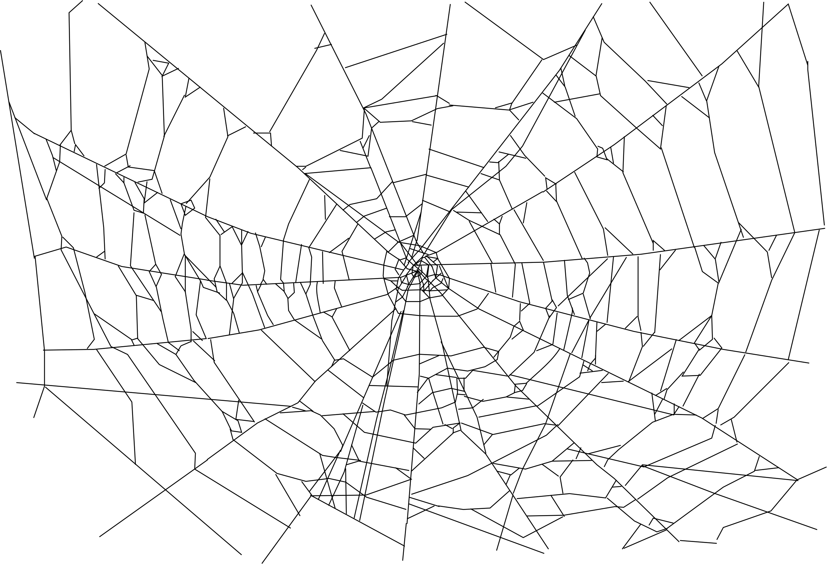
Problem: split ownership
True Concurrency requires us to have multiple components that can be owned and operated independently
Problem: How do we reason about the system if we don’t have ownership of the whole thing?
We need an invariant that “reaches across space”

Slide 57
Example 2: Producer/consumer queue
Producer
Producer
Producer
Producer
Queue Buffer
Consumer
Consumer
Consumer
Consumer

Slide 58
Example 2: Producer/consumer queue
Thread 1
Producer
Thread 2
Consumer
Shared across threads:
Thread 3
Producer
Thread 4
Producer
Arc<
>
Queue Buffer
Thread 5
Producer
Thread 6
Consumer
Thread 7
Consumer
Thread 8
Consumer

Slide 59
Example 3: “Agreement”
fn update_pair(mut token0: Token,
mut token1: Token, new_value: u64
) -> (pair: (Token, Token))
requires token0.id == token1.id
ensures
pair.0.value == new_value,
pair.1.value == new_value,
pair.0.id == token0.id,
pair.1.id == token1.id,
{
token0.value = new_value;
token1.value = new_value;
(token0, token1)
}
fn validate_pair(token0: &Token, token1: &Token)
requires token0.id == token1.id
ensures token0.value == token1.value
{
/* ? */
}
struct Token {
id: Id,
value: u64
}
fn new_pair(value: u64) -> (pair: (Token, Token))
ensures
pair.0.id == pair.1.id,
pair.0.value == value,
pair.1.value == value,
{
let id = fresh_id();
(Token { id: id, value: value },
Token { id: id, value: value })
}

Slide 60
Example 3: “Agreement”
fn update_pair(mut token0: Token,
mut token1: Token, new_value: u64
) -> (pair: (Token, Token))
requires token0.id == token1.id
ensures
pair.0.value == new_value,
pair.1.value == new_value,
pair.0.id == token0.id,
pair.1.id == token1.id,
{
token0.value = new_value;
token1.value = new_value;
(token0, token1)
}
fn validate_pair(token0: &Token, token1: &Token)
requires token0.id == token1.id
ensures token0.value == token1.value
{
/* ? */
}
struct Token {
id: Id,
value: u64
}
fn new_pair(value: u64) -> (pair: (Token, Token))
ensures
pair.0.id == pair.1.id,
pair.0.value == value,
pair.1.value == value,
{
let id = fresh_id();
(Token { id: id, value: value },
Token { id: id, value: value })
}

Slide 61
Example 3: “Agreement”
fn update_pair(mut token0: Token,
mut token1: Token, new_value: u64
) -> (pair: (Token, Token))
requires token0.id == token1.id
ensures
pair.0.value == new_value,
pair.1.value == new_value,
pair.0.id == token0.id,
pair.1.id == token1.id,
{
token0.value = new_value;
token1.value = new_value;
(token0, token1)
}
fn validate_pair(token0: &Token, token1: &Token)
requires token0.id == token1.id
ensures token0.value == token1.value
{
/* ? */
}
struct Token {
id: Id,
value: u64
}
fn new_pair(value: u64) -> (pair: (Token, Token))
ensures
pair.0.id == pair.1.id,
pair.0.value == value,
pair.1.value == value,
{
let id = fresh_id();
(Token { id: id, value: value },
Token { id: id, value: value })
}

Slide 62
Example 3: “Agreement”
fn update_pair(mut token0: Token,
mut token1: Token, new_value: u64
) -> (pair: (Token, Token))
requires token0.id == token1.id
ensures
pair.0.value == new_value,
pair.1.value == new_value,
pair.0.id == token0.id,
pair.1.id == token1.id,
{
token0.value = new_value;
token1.value = new_value;
(token0, token1)
}
fn validate_pair(token0: &Token, token1: &Token)
requires token0.id == token1.id
ensures token0.value == token1.value
{
/* ? */
}
struct Token {
id: Id,
value: u64
}
fn new_pair(value: u64) -> (pair: (Token, Token))
ensures
pair.0.id == pair.1.id,
pair.0.value == value,
pair.1.value == value,
{
let id = fresh_id();
(Token { id: id, value: value },
Token { id: id, value: value })
}

Slide 63
Example 3: “Agreement”
fn update_pair(mut token0: Token,
mut token1: Token, new_value: u64
) -> (pair: (Token, Token))
requires token0.id == token1.id
ensures
pair.0.value == new_value,
pair.1.value == new_value,
pair.0.id == token0.id,
pair.1.id == token1.id,
{
token0.value = new_value;
token1.value = new_value;
(token0, token1)
}
fn validate_pair(token0: &Token, token1: &Token)
requires token0.id == token1.id
ensures token0.value == token1.value
{
/* ? */
}
struct Token {
id: Id,
value: u64
}
fn new_pair(value: u64) -> (pair: (Token, Token))
ensures
pair.0.id == pair.1.id,
pair.0.value == value,
pair.1.value == value,
{
let id = fresh_id();
(Token { id: id, value: value },
Token { id: id, value: value })
}

Slide 64
Example 3: “Agreement”
fn update_pair(mut token0: Token,
mut token1: Token, new_value: u64
) -> (pair: (Token, Token))
requires token0.id == token1.id
ensures
pair.0.value == new_value,
pair.1.value == new_value,
pair.0.id == token0.id,
pair.1.id == token1.id,
{
token0.value = new_value;
token1.value = new_value;
(token0, token1)
}
fn validate_pair(token0: &Token, token1: &Token)
requires token0.id == token1.id
ensures token0.value == token1.value
{
/* ? */
}
struct Token {
id: Id,
value: u64
}
fn new_pair(value: u64) -> (pair: (Token, Token))
ensures
pair.0.id == pair.1.id,
pair.0.value == value,
pair.1.value == value,
{
let id = fresh_id();
(Token { id: id, value: value },
Token { id: id, value: value })
}
Who maintains this invariant?

Slide 65
Verus’s System: VerusSync
Provides a means for “space-reaching invariants”
Acknowledges that real systems need invariants a little more complicated than two-party agreement.

Slide 66
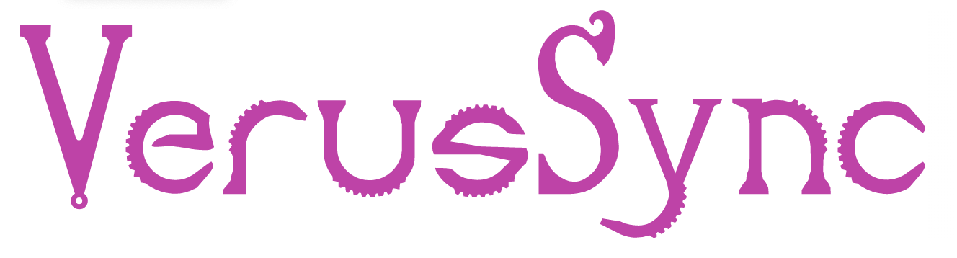
Verus’s System: VerusSync
VerusSync provides:
Ghost objects (like PointsTo)
Developer defines:
State
VerusSync
Operations
Invariants
With a space-reaching invariants

Slide 67
Verus’s System: VerusSync

Slide 68
Verus’s System: VerusSync
You can connect the ghost state to other state you care about via more lock invariants

Slide 69

Notes:
The space-reaching invariant reaches through the ”ghost dimension”

Slide 70
[Demo: VerusSync]

Slide 71

Recap
Memory permissions
Space-reaching invariants
Lock invariants

